Slide 1

PYTHON PROJECT
Or shukrun - 036043891
Mary azencot - 302560503
Luba Zameslov - 311929707

Slide 2
Introduction
In this project we examined and analyzed data from a communications company in order to predict whether a customer will churn and what is the chance of that to happening.
In the analysis we will try to decipher why the customers are leaving and whether this can be predicted in order to prevent the customer from leaving.

Slide 3
The Problem
73.5% of the customer are leaving the company.
We will try to predict What causes the customer to abandon the company and how the company's service can be improved in order to minimize the abandonment.
Issue to explore:
What kind of services our clients have?
How loyal are they?
What makes them leave?
When did they choose to end their relationship with the company?
Based on what reason did they end their relationship with the company?
Does costumer behaviour reflect on the abandonment ratio?

Slide 4
Data Description
What information do we have within our data:
We have 7,043 row (clients)
Gender info – F/M
Type of service info - the company has 3 types of services: phone, internet and tv
Customer account info – contract type: Month-to-month / One year / two year
Payment method info – monthly charge / total charge
Seniority info – months / years
Churn info

Slide 5
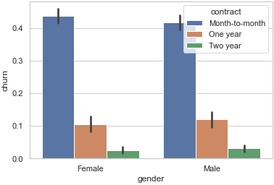
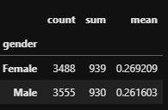
Gender
We have 7,043 clients with a total of 3,555 men's and 3,488 women's.
We tried to make some assumptions about the gender:
If there any difference between the gender on there loyalty to the company?
We can see that there is no different between the men's and women's on there loyalty.
If there any difference between the gender on there behavior?
We can see that the general customer behavior is a month-to-month contract.
Male are slightly more active in the long term contract then female

Slide 6
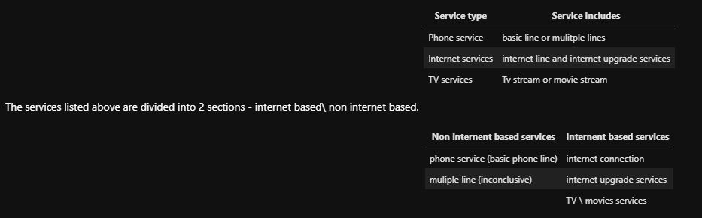
Service type
We are going to explore how many customers are active in each service and how it reflects on the churn.
The Company's Services Are:
phone service
multiple lines
internet service
online security
online backup
device protection
Tec support
Streaming tv
streaming movies

Slide 7
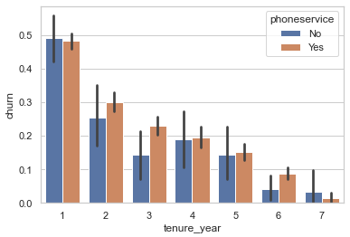
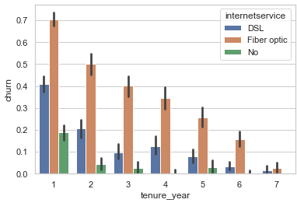
Service type
phone service: the majority of abandonment rate is within the first year of use.
multiple lines : there is a lot of clients that don’t have a phone service, there for cannot be activated with this service. The majority of abandonment rate is within the first year of use.
internet service: We can see that most clients have fibre optic infostructure.
First year we have 880 active clients with fibre optic, and 709 active clients with DSL.
The premise above gat reinforcement by accompaniments ratio of abandonment based on general public: In the general population we have a ratio of 48.2% churn (abandonment) within the first year, in the internet service the ratio is 70.3% churn in fibre optic and 40.9% in DSL. The same behaviour reflected in the second year: the general population ratio of churn is 29.5%, in the internet service the ratio is 50% churn in fibre optic and 20% in DSL.in the internet service the ratio is 70.3% churn in optic and 40.9% in DSL

Slide 8
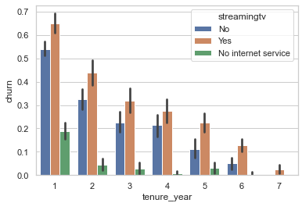
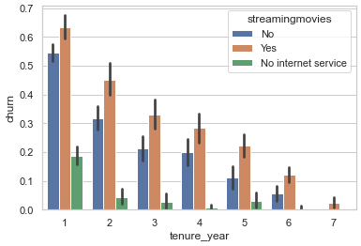
Service type
online security, online backup, Tec support and device protection: We can see that most clients chosen NOT to buy this service.
streaming tv and streaming movies :This service requires internet connection, and as we established the internet infrastructure is probably not good enough. from 1,589 active internet customers (fibre optic + DSL) in the first year, only 456 clients upgraded their internet services. the abandonment ratio in the first year by general population is 48.2%, in this service the ratio is 64.9%.

Slide 9
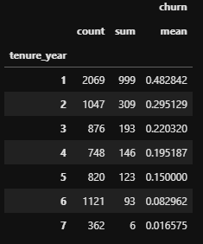
Our customers
We have 7,043 clients. only 1,869 of them are active and 5,174 is unactive. (26.536987%) actives
As we can see 48.2% of our customers has abandum the company after the first year.

Slide 10
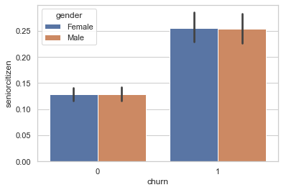
Our customers
We have 1,142 senior citizen clients. Their share is (16.214681%) from the company's clients.
- We try to check is there any difference in the senior citizen clients about the churn and gender.
We find out that 2/3 of the senior citizen are not active
They behavior of both clients (general and senior citizen) are the same, the preferer to have ‘month to month’ contract.

Slide 11

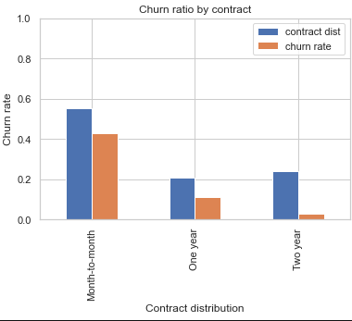
Customer Account
In order to check the churn behaver based on type of the contract we create a new data frame for each contract:
Conclusion:
The highest ratio of abandonment is within the ‘Month to month’ contract - 42.7%
With ‘One year’ contract the ratio of abandonment is 11.2%
With ‘Two year’ contract the ratio of abandonment is 2.8%
55% out of all customers chosen a Month-to-month contract
21% out of all customers chosen a One-year contract
24% out of all customers chosen a Two-year contract

Slide 12
Payment Method
The company have 4 payment method:
- Bank transfer
- Credit card
- Electronic check
- Mailed check

Slide 13
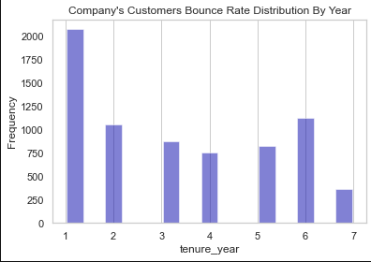
Seniority
Month to month: clients with that contract are active for 7 months (Avg)
One year: clients with that contract are active for 48 months (Avg)
two year: clients with that contract are active for 65.5 months (Avg)

Slide 14
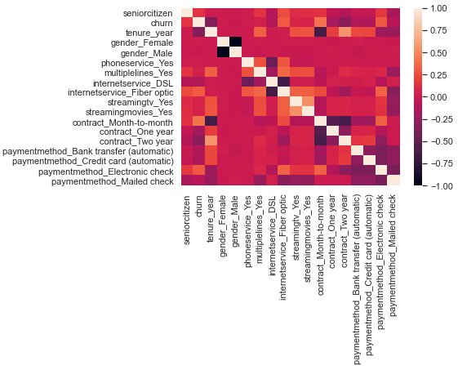
Churn
We can see in our analysis that there is a strong connection/correlation between the month over moth contract to the churn. Customers with this contract don’t want to commit to the long term from the beginning, we can assume they don’t have exit penalties that prevent them from leaving.

Slide 15
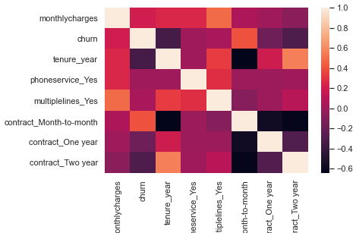
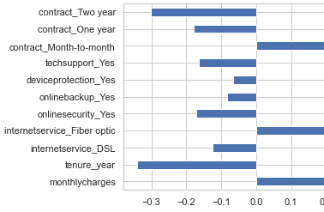
Churn
We have a strong correlation between month to month contract and the churn.
We have a strong negative correlation between the churn and tenure year
We have mid correlation between the churn and monthly charges.

Slide 16
Data Engineering
We converted the Seniority from months into years
Changing all text to lower letter
Labe column to numeric
changing the column churn from ‘object’ to ‘int’ In order to perform calculations on it (no=0, yes=1).
Droping unnecessary columns: Customer Id, Total Charges, Partner, Dependents
We create new data frame for ‘month to month’ , ‘one year’, ‘two year’ contract.

Slide 17
Data Mining
Now that we have a background based on the data we have,
We will be able to develop a model that will know how to investigate and give quick and accurate conclusions about a new database in any quantity required

Slide 18
Train Table
abel = ‘chrun’
cid = ‘customerid_new’
# Lable alone
train_lable = train_table[label]
# Customerid alone
train_cid = train_table[cid]

Slide 19
The process of creating Mashin Lerning
1) Arranging and organizing the database we call company DT Dividing the information into several tables:
The label that is the main issue I am researching=>label
The ID column data to be arranged in the form of an index => cid
All the additional features that this is the content of the information through which we will be investigated.
2) Dividing the information into two parts the training and the test.
In the training phase we will take 80% of all the information with the label and all the data before in such a way I actually soldier the model and let the model understand how to interrogate.
In the test phase we will put in the model the 20% of the information that remains at the feature level only without the label, the model will give me the output (test size 1400)
In the last step we will compare the results of the training phase and the test phase and check if the percentage that comes out is similar, so we can know how reliable and accurate the model we created is the acressy.
** and through this we can now use each additional / new database and understand what it means.

Slide 20
Decision Tree
We use the model to establish the main reasons and Proselytise for clients abandonment.
The data was divided by 80/20 percent with gender orientation (Gender provide us with an homogenic division)
1,400 rows was left aside and the rest of the data where uploaded to the model for exploration.
As we can see, the first Gini refers to monthly contract (0.39), with the highest probability of churn.
That’s make sense since month to month payment is higher and clients with this kind of contract makes proper disclosure regarding their loyalty to the company (No “long run” contract).
If the customer is also male, who has a fibre optic line, the probability is 0.49 (Gini grade) that he will not last more than 13 months as an active client.
If the customer is female with fibre optic line, the chances are she want last more then 4.5 months (0.493).
Those conclusions are inline with our previous research - Fibre optic Internet service is a low value product that’s explains the high churn ratio.. Plus, month to month contract is a “short term” commitment and promises the clients the ability to leave at any point.

Slide 21
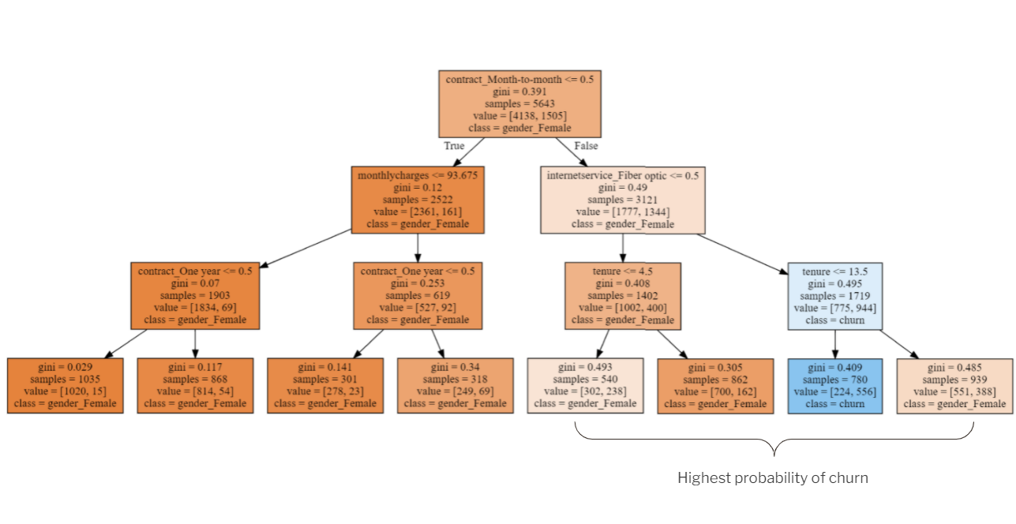

Slide 22
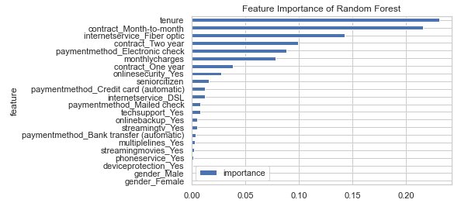
Random Forest Model
Looking at the random forest feature importance
KNN – K Nearest Neighbours
The model will issue us an output data frame with the customerid data and churn happened and churn_predicted_by_model in the form of a csv file 'my_Knn_Prediction.csv’

Slide 23
Accuracy Check
1)Decision Tree = test_acc : 0.77928
2) Random Forest = test_acc : 0.77642
3) Knn = test_acc :0.76
CONCLUSIONS:
"Decision Tree" algo had the best result, "Knn" with 2% less accuracy
We can Rebuild the data in the model in order to achieve better result. However, we used all the important features we have.
To our opinion - we need more data and/or new data (features) to improve the model

Slide 24
Overfitting
Decision Tree:
*Max depth = 5 looks like the best one
Random Forest:
n_estimators = 10 ~ 78% accuracy
Knn:
n_neighbors = 4 ~ 77.9% accuracy

Slide 25
The analysis of the data for the highest chances of abandonment will be done on a division tree when in each path will be performed according to the gini index the chances of abandonment of the company.
The highest GINI index refers to a monthly contract.
That is, customers with this type of contract are most likely to abandon.
The probability of leaving customers, in a contract of this type, will increase / decrease with the other parameters

Slide 26
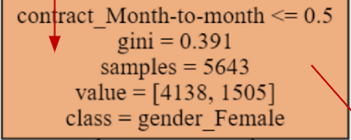
The most homogeneous division is gender
In our show the most homogeneous division is gender, out of 5,643 men and women,
4,138 left the company and disconnected from the service

Slide 27
Explanation of the tree Left side division by gender - women
% When it comes to women and the same characteristic choose the monthly contract model
It seems that out of 2522 women, 93.6% will leave society.
The gini index is 0.12 so it is a very high level of accuracy and it strengthens our conclusion that there is a direct relationship to a renewable contract for high abandonment
% Out of 1903 women, when it will be a contract that is renewed from year to year the percentage of abandonment will be 50% and gini 0.07

Slide 28
Explanation of the tree right side division by gender - men
The right side of the tree begins with the division into men,
This side shows a higher probability of abandonment (the darker the color is orange).
That is, we get reinforcement that men are most likely to quit. In any probability (branching), they present a high probability of abandonment.
* We have seen that the percentage of gender distribution of all the company's customers is quite the same (almost equal distribution), so the difference in behaviour is interesting

Slide 29
Conclusions
The highest GINI index refers to a monthly contract.
That is, customers with this type of contract are most likely to abandon.
The probability of leaving customers, in a contract of this type, will increase / decrease if the other parameters listed below are met:
Conclusions:
Pretty aligned with what we saw in the correlations, tenure (period of time) along with month to month contract are the main reason for abandonment

